Slide 1
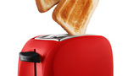
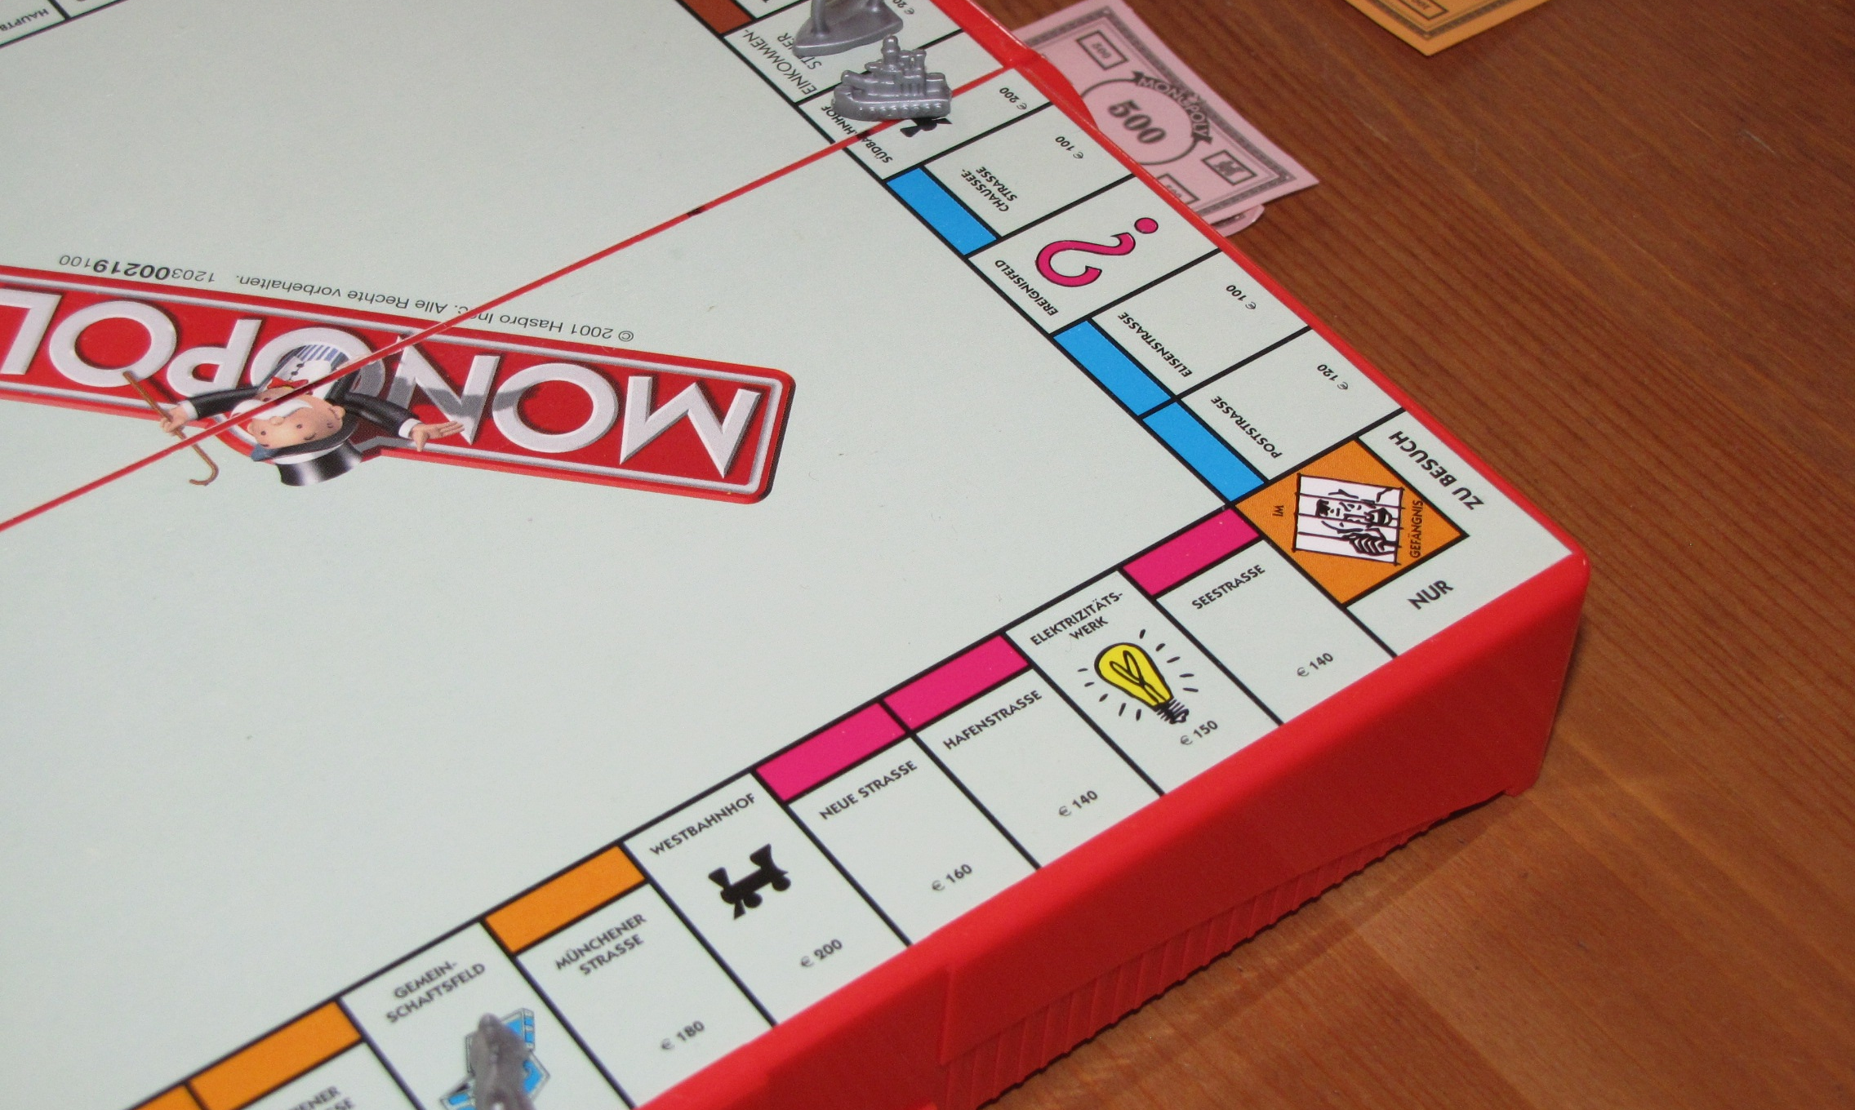
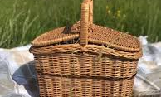
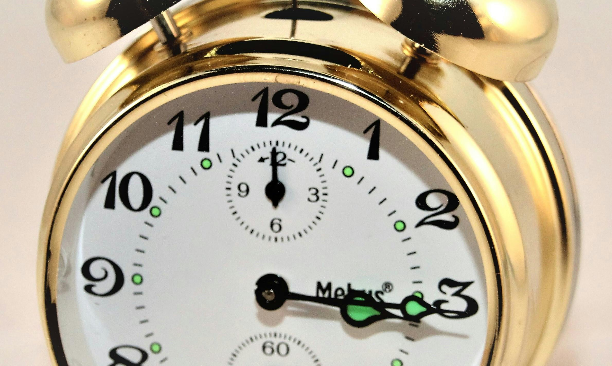

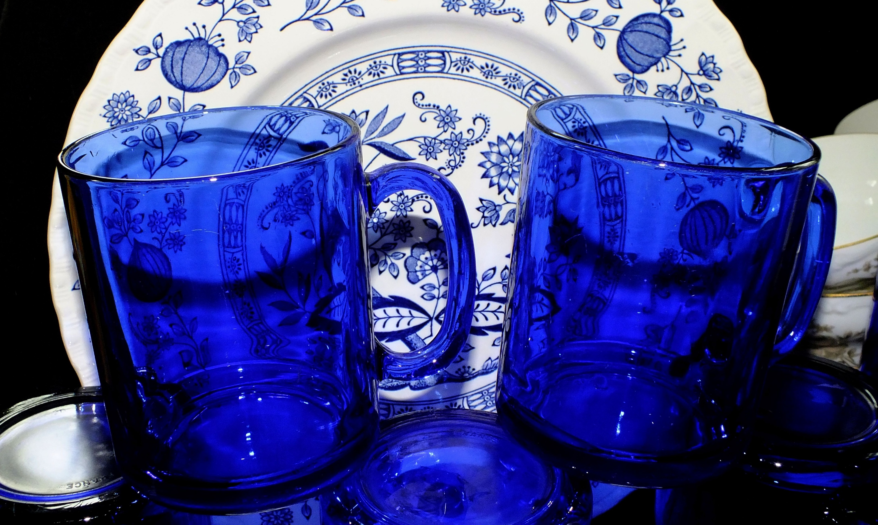
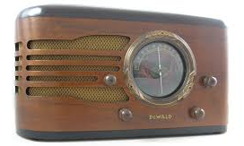
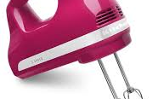
Dalton Swap shop aka dal-mart Dalton Transfer station Don’t toss it –share it bring your gently used unwanted items & small appliances and trade for something you need. Give an item a happy home beginning May 1, 2026 Hours of operation Fridays & Saturdays 10:00-2:00 open to all Dalton residents (no transfer station sticker required) Interested in volunteering? Call 413-684-6111 x 202

